Slide 1


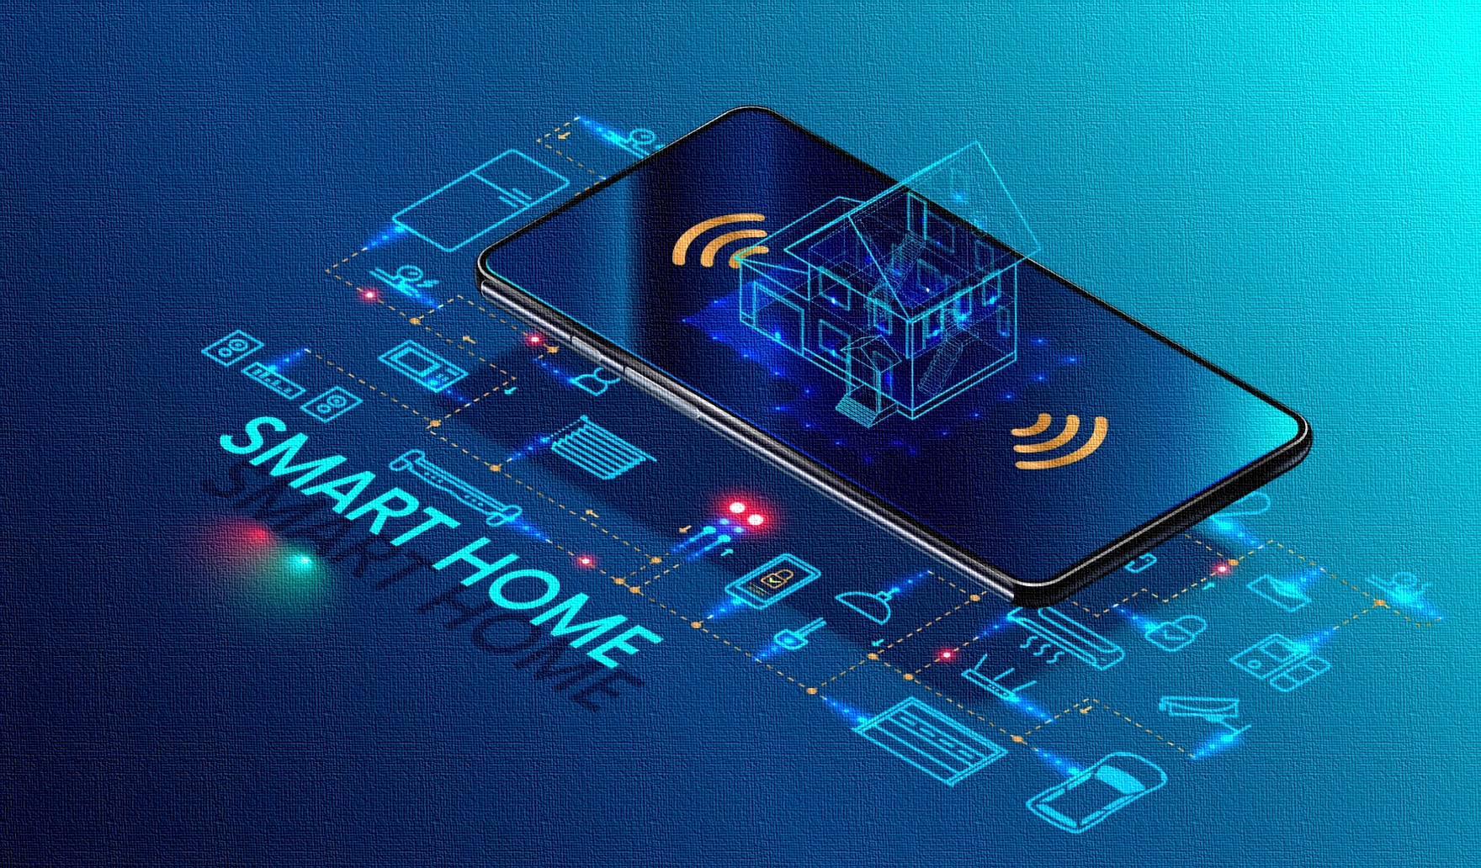
General Sir John Kotelawala Defense University
Home Automation
System
D/BIT/23/0023
D/BIT/23/0008
D/BIS/23/0016
D/BIS/23/0029
Group- 11

Slide 2
Problem Define
Unable to control all electronic devices when residents are not at home.
Power consumption is high.
Solution
By using this Home Automation System, We can control all Electronic devices of Home anywhere of the world. When resident are not at home, We can control through smart Device by connecting IOT Cloud.

Slide 3

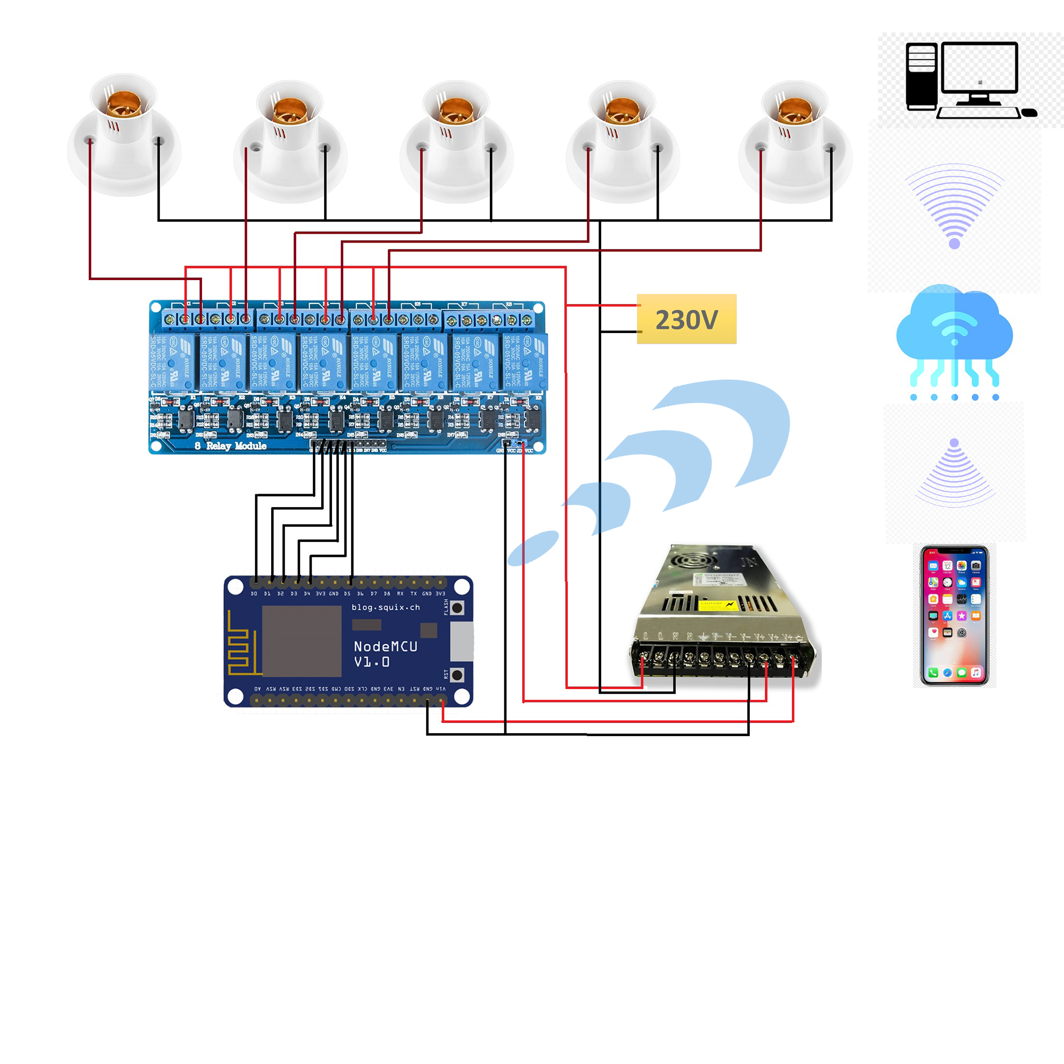
System Overview

Slide 4
Members Contribution
Member | Contribution
D/BIT/23/0023 | Set upping Hardware
D/BIT/23/0008 | Making Programing Code
D/BIS/23/0016 | Building Architecture
D/BIS/23/0029 | Designing Architecture

